Slide 1
Error Boundary In React Application

Slide 2
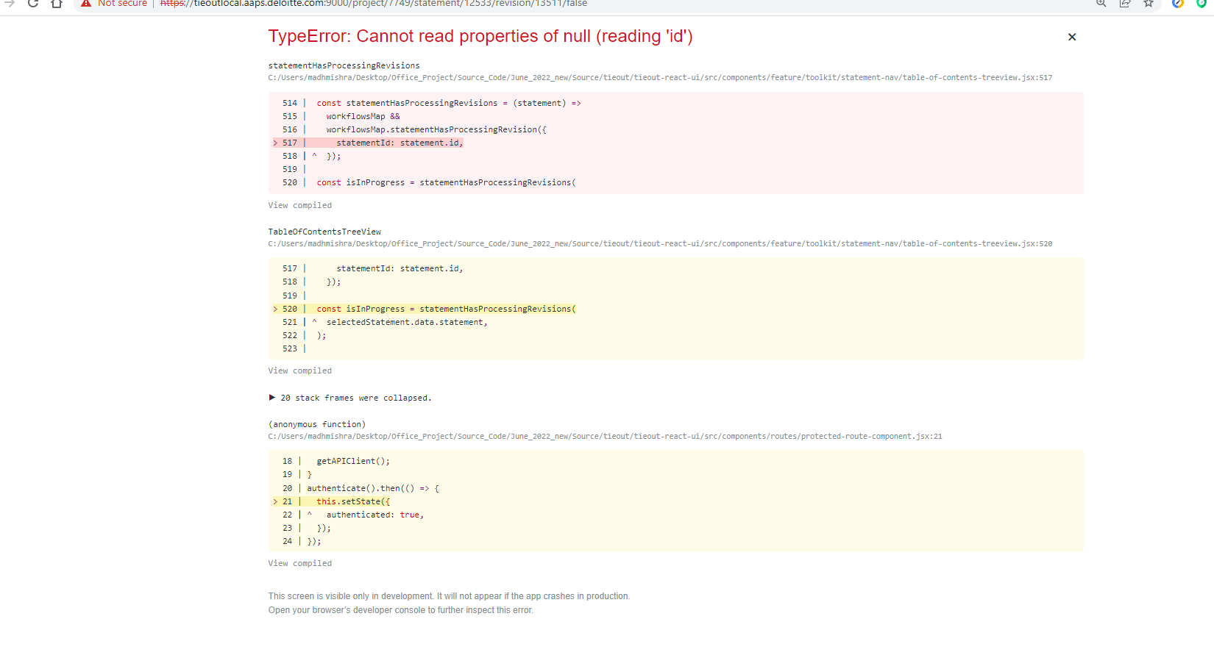
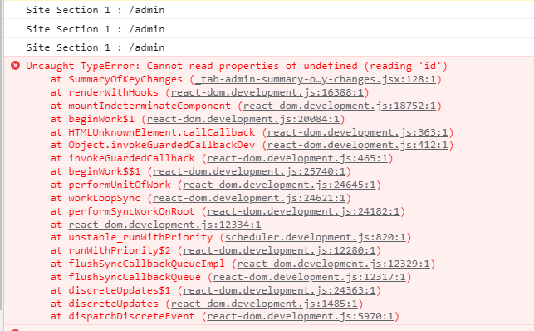
Objective
Prevent error screen displayed to end user when application crashes
Give useful insights to developer
Detect error due to failed Api call.
Detect error due to invalid state of data model
Show loading icon while data is being loaded

Slide 3
Problem
The error details image shows the details which are difficult to understand and decode.
The error details does not say,
if there was a failed api call and if that caused data to be undefined.
if some data model also went to invalid state.

Slide 4
Solution
Developed Error Boundary plugin / component using the below features
Fallback UI
React lifecycle methods for error boundary
Interceptor from Axios
Base64 data encryption to encrypt error details
Below are the benefits of this component.
When application crashes it will fail gracefully with some good fallback UI
Give useful insights to developer

Slide 5
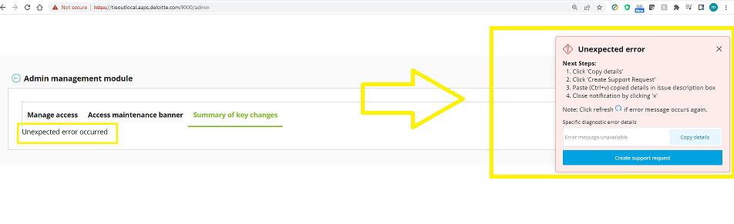
Benefits Explained
When application crashes it will fail gracefully with some good fallback UI.

Slide 6
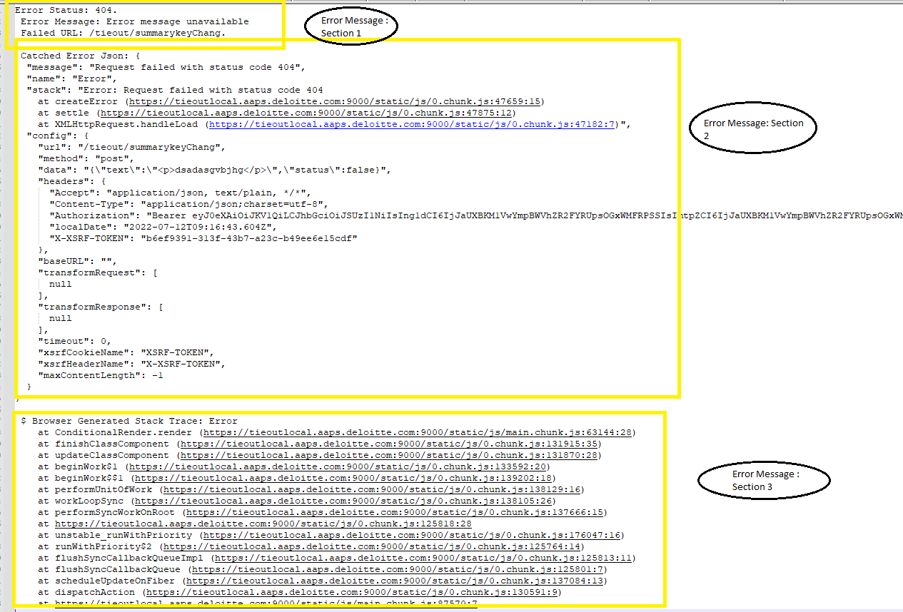
Benefits Explained
Give useful insights to developer
The error is more descriptive now with lots of details, as seen in below image
Section 1
Talks about, if the error is caused or accompanied by some failed api calls. It shows failed url details, if any.

Slide 7
Benefits Explained
Section 2
Error caught inside try/catch block which has pushed model into invalid state temporarily.

Slide 8
Benefits Explained
Section 3:
The stack trace. It gives details about the propagation of error from top level component to bottom components/javascript files.

Slide 9
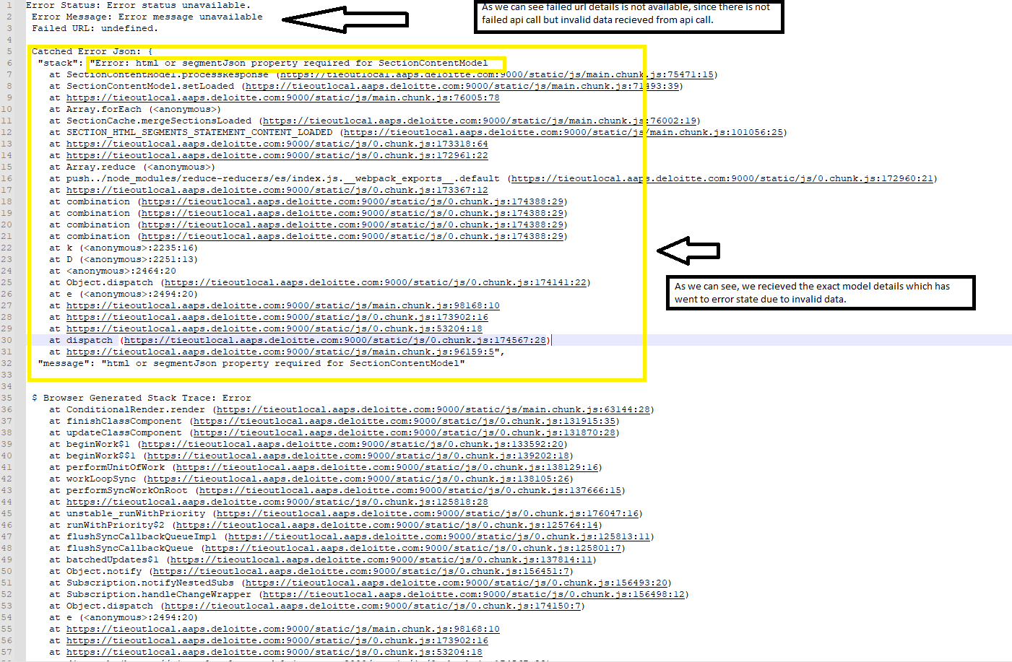
Benefits Explained
Sometimes the error might not occur due to failed api call but only due to invalid model state.
Let’s say FE received invalid data (string instead of number) which pushed our model to invalid state.
We can capture those details as well, in much more descriptive form:

Slide 10
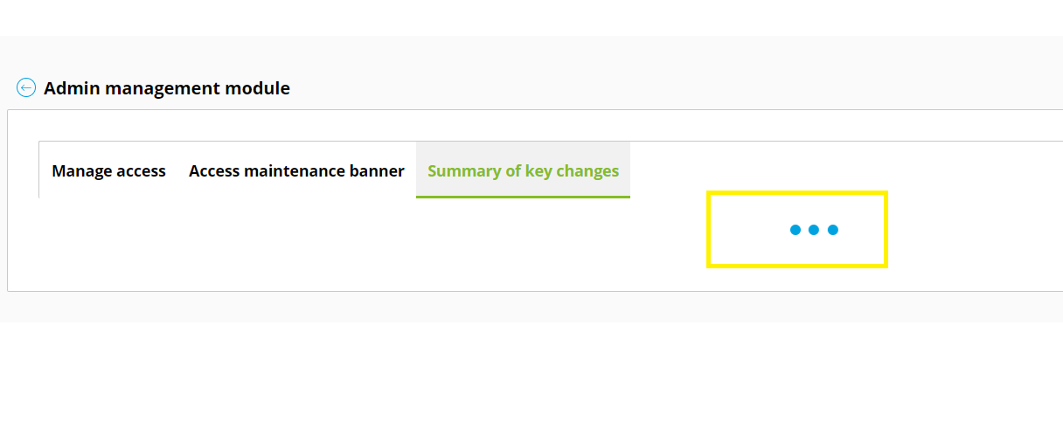
Benefits Explained
While wrapping some child component inside Error Boundary we can also trace if the child component needs some data to render properly and show load icon to user till the concerned data is loaded/processed.

Slide 11
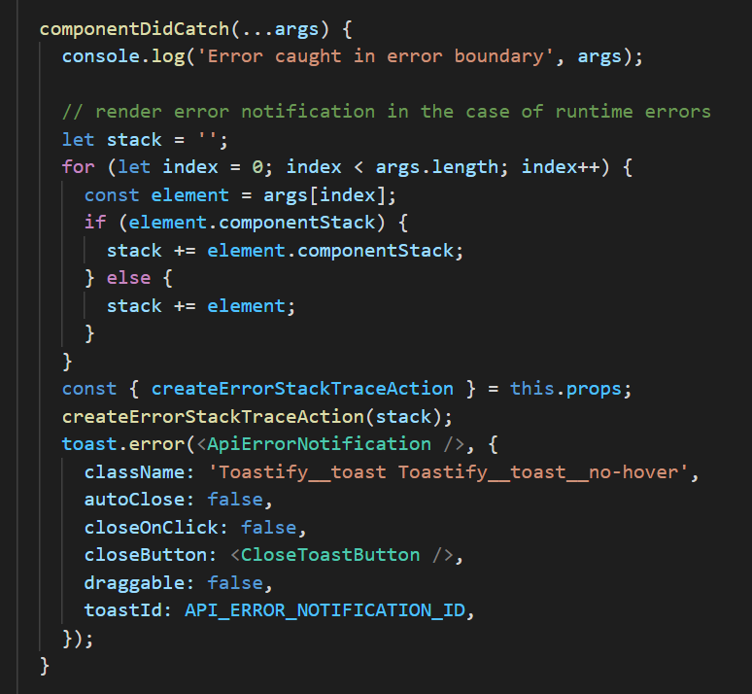
Implementation Details
Brief Description:
Error Boundary component is used to catch JavaScript errors anywhere in the child component tree, log those errors and display a fallback UI ‘instead of’ the component that crashed.
A class component becomes an error boundary if it defines either (or both) of the lifecycle methods:
static getDerivedStateFromError ()
componentDidCatch();
In Tieout application we are using componentDidCatch();
Image on the right side, shows how we can define componentDidCatch() inside our Error Boundary Component

Slide 12
Implementation Details
Apart from componentDidCatch() we also customized our Error Boundary component such that it catches error for the failed api calls (using axios response interceptors), error thorough invalid state of models (By inheriting all model from some base model class which has an error props inside it).
Basically, all our component will be using some data to interact with end user. So, we want to make sure that the data they are using is not invalid/corrupt. If in case that is invalid, we want to raise a flag (through pop up).
Question: How should we implement it? What components are required? What is the data model?

Slide 13
Implementation Details
Building an error model
Your error model should have ability to capture following error details :
Error status
Error Message
Failed Url
Catched error Json string (it consists of data or invalid state transition that caused error)- For example we want to log the error json for failed api call from backend.
Stack trace - To know how the error propagated from its original occurrence to down to different levels in an application.
There should be a functions inside error model class for updating the above properties.
Using this structure/model data we can maintain a redux state so that we can update it from anywhere inside the application

Slide 14
Implementation Details
Building an Error Boundary component
This component is used to handle applications crashes, failed api calls, error in models and other catched error (error caught in try catch block).
For error boundary component to come in action while application crashes, the application component should be wrapped inside error boundary component such that there is parent child relationship between them.
For example:
<ErrorBoundary>
<HomePageComponent />
<LeftPanelComponent />
<RightPanelCompoent />
</ErrorBoundary>
You can wrap as many components as possible, individually, inside our <ErrorBoundary> component so as to get granular and more specific details about the error.
How do we capture error inside error boundary component:
For capturing error details, you need to implement ComponentDidCatch lifecycle method as shown in the image:

Slide 15
Implementation Details
For any application crash due to child of <ErrorBoundary> component, componentDidCatch () is called with error log details as its parameter.
You can use these details to update error model of redux state, which can further be used to show pop with button to copy error details to clipboard. This copied error details can be shared with developer for further investigation.
Next, suppose there is a component which made some api call. Let’s say that api call returned with some invalid data/ invalid parameter inside response. You can detect this dynamically using our <ErrorBoundary> component.
<ErrorBoundary> component just requires ‘error’ props to detect this.
For example:
<ErrorBoundary dependencies = [error]>
<ComponentA />
</ErrorBoundary>
Now when you detect invalid response/erroneous model state, you can update the ‘error’ state and fire pop up for the error.
Next user can copy error details from the pop up and share with developers.
Below image depicts how we implemented this in our application:

Slide 16
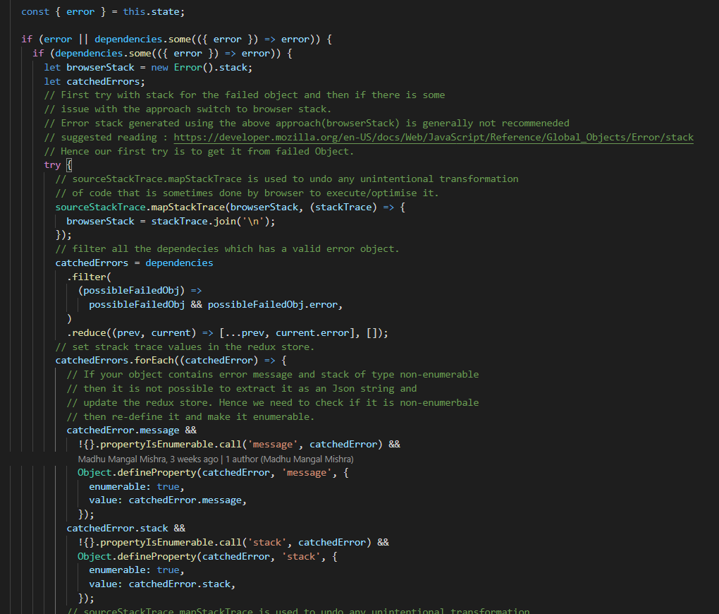
Sneak peek of Error Boundary component:
Implementation Details

Slide 17
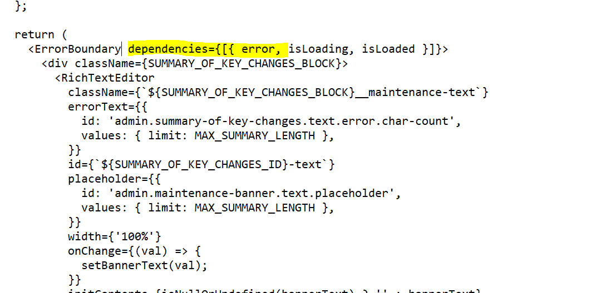
Implementation Details
How to wrap child components inside our Error Boundary Component ?
Below is an example

Slide 18
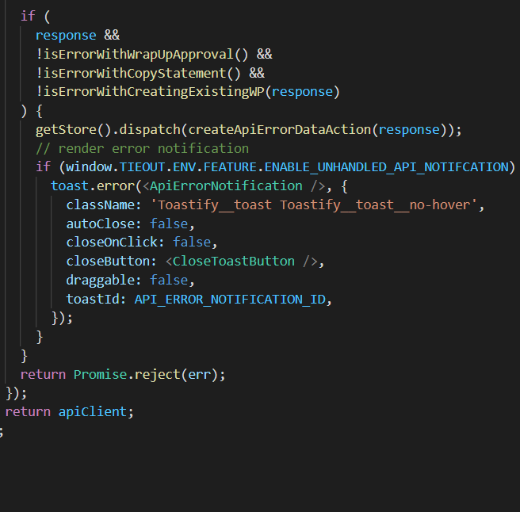
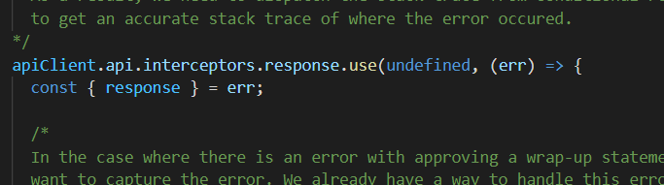
Implementation Details
How to log failed api call details ?
You can achieve that using response interceptor.
Whenever you detect failed api calls you can trigger pop up with error details.
Following image describes, how to do:

Slide 19
Useful Links
https://developer.mozilla.org/en-US/docs/Web/JavaScript/Reference/Global_Objects/Error
https://reactjs.org/docs/error-boundaries.html
https://www.npmjs.com/package/react-error-boundary

